Slide 1
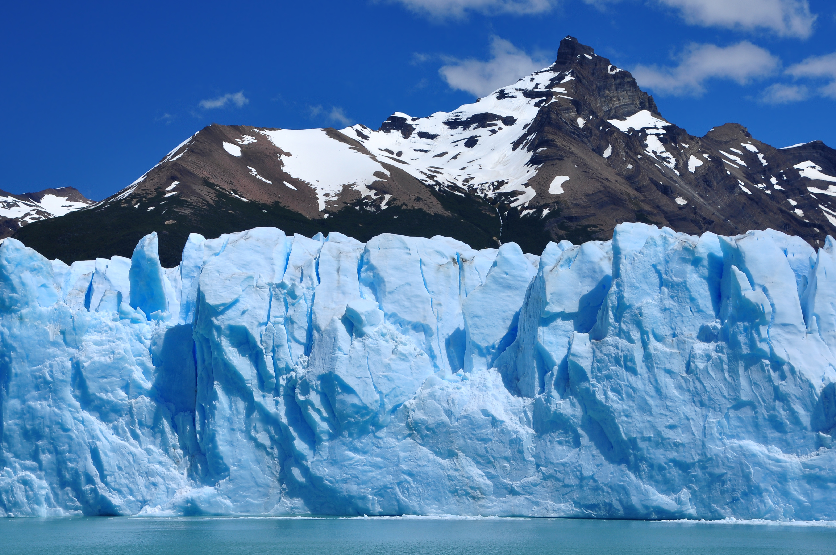


A Reusable Framework for Regional Climate Model Evaluation
Andrew F. Hart, Cameron E. Goodale, Chris A. Mattmann, Peter Lean, Jinwon Kim, Paul Zimdars, Duane E. Waliser, Daniel J. Crichton
AGU Fall Meeting, 06.Dec.2011. San Francisco, CA.

Slide 2
Index
Science Rationale
System Goals
System Architecture
Supporting Reuse
Applications
Contact

Slide 3
RCMES Science Rationale
Why is it important to develop a Regional Climate
Model Evaluation System?

Slide 4
Science Rationale...
Increasing interest in climate models for local, near-term decision support
New emphasis placed on regional scale and decadal timeframes vs. global, long-term models
Multiple International efforts seeking to provide a better understanding of Earth’s climate through modeling

Slide 5
Science Rationale...
Intergovernmental Panel on Climate Change (IPCC)
5th Assessment Report focuses on regional, short-term models
Co-ordinated Regional Climate Downscaling Experiment (CORDEX)
Gridding multiple regional models
Evaluating large models against vast amounts of observations
Computationally intensive

Slide 6
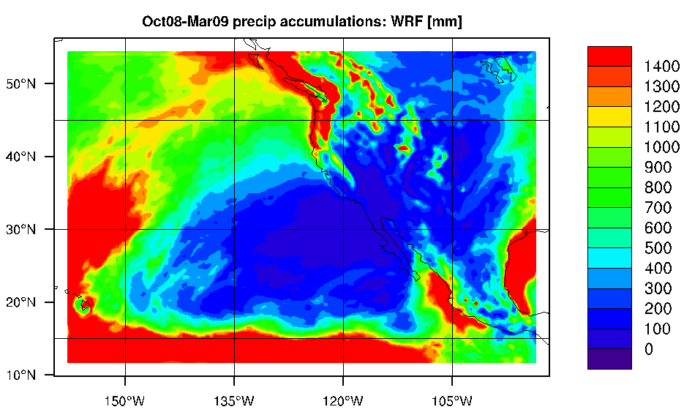
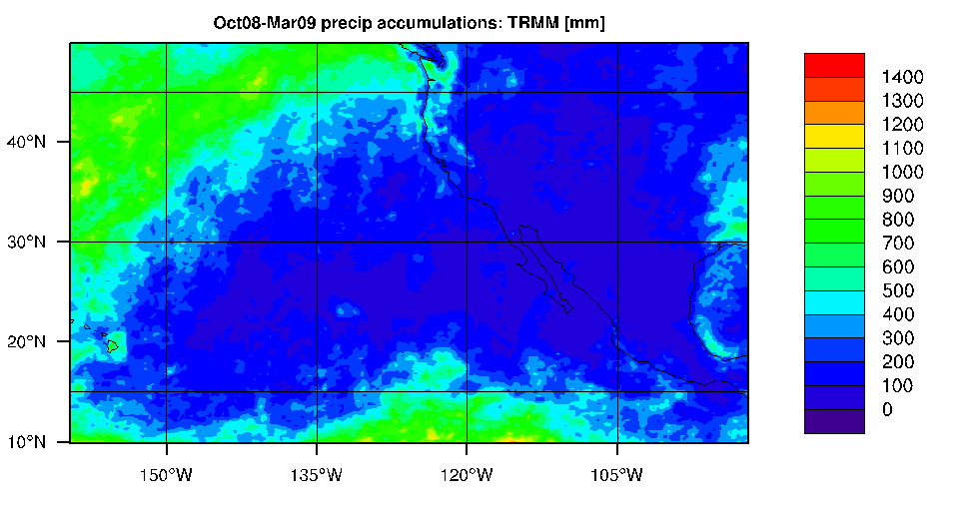
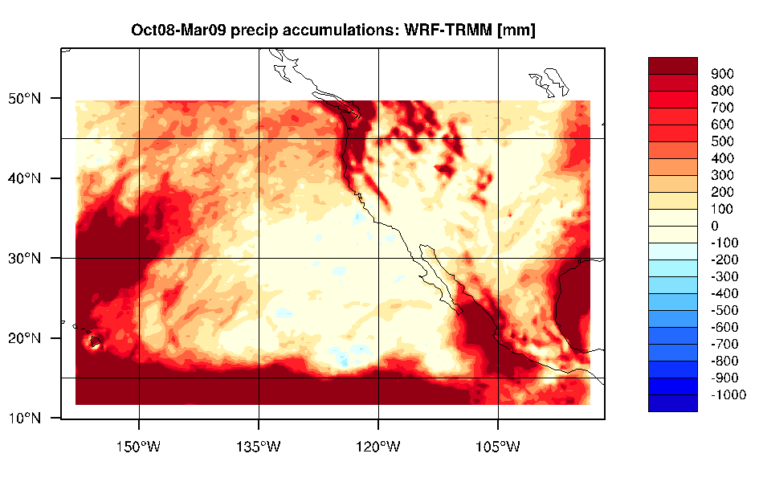
Science Use Cases...
Bias Calculation

Slide 7
Science Use Cases...
Bias Calculation

Slide 8
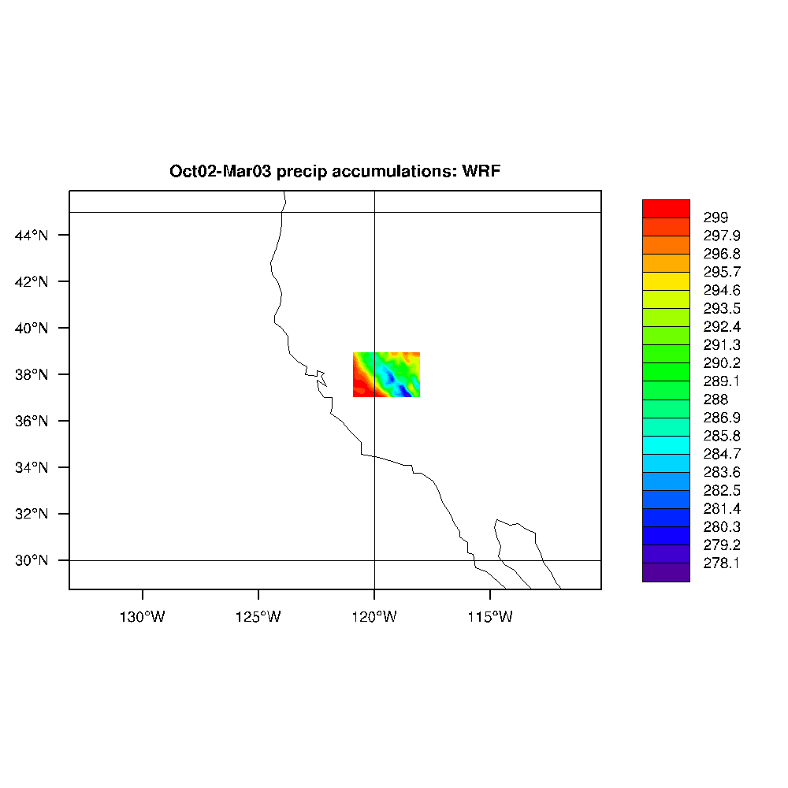
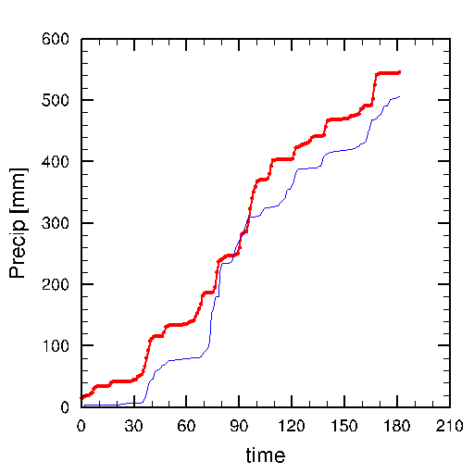
Science Use Cases...
Area Averaging
Area mean accumulated precipitation within box
WRF d02
TRMM
(days)

Slide 9
Science Rationale...
Data Identification
Finding the right observational data to use
Data Preparation
Acquiring and formatting data for comparison
Data Processing
Reliable, repeatable computation at scale

Slide 10
RCMES System Goals
How will the Regional Climate Model Evaluation System change the status quo?

Slide 11
System Goals...
Normalize the formats and metadata models of the observational datasets
Support the ability to scale as additional datasets are identified for inclusion
Provide the community with model evaluation tools that integrate with the observational data

Slide 12
System Goals...
Reduce redundant code generation (ad-hoc development of common routines)
Provide programmatic access to the data store and support common output formats
Provide user-friendly configuration wizards for common tasks

Slide 13
System Goals...
“Reduce the time and effort required to perform regional model-to-data comparisons”
“Free scientists to focus on their science, not data management.”

Slide 14
RCMES System Architecture
How is the Regional Climate Model Evaluation System designed to meet its goals?

Slide 15
System Architecture...
Two complementary systems:
RCMED – Scalable data store for observational data from multiple sources
RCMET – Client toolkit for interacting with RCMED to do model-to-obs. comparisons

Slide 16
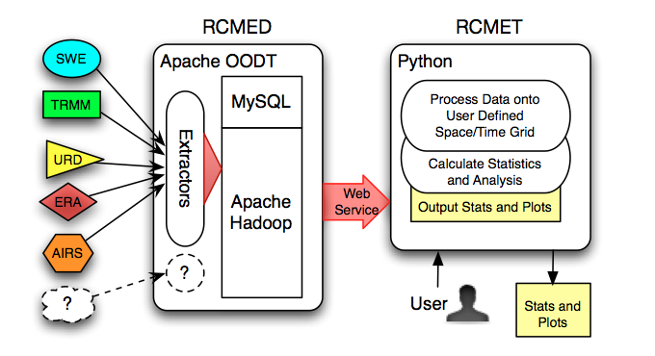
System Architecture...
System Overview

Slide 17
System Architecture...
RCMED:
Scalable container for decades of observations from multiple sources, aligned to a common data model
Optimized for regional climate modeling query characteristics

Slide 18
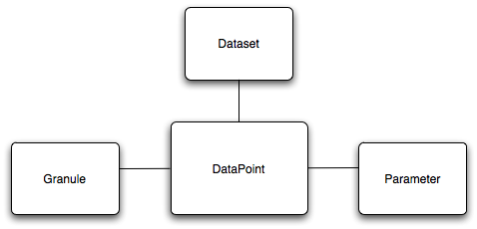
System Architecture...
RCMED Data Model:
Every observational measurement becomes a data point anchored in space and time, linked to the parameter being observed, the granule of origin, and the dataset.

Slide 19
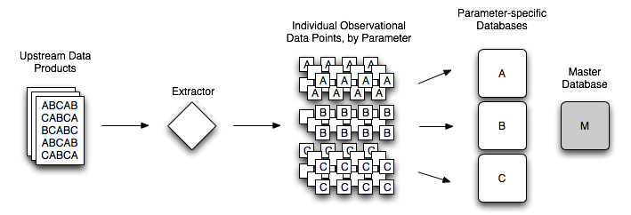
System Architecture...
RCMED Data Ingestion
Data points are extracted and loaded into parameter-specific databases indexed by a master database

Slide 20
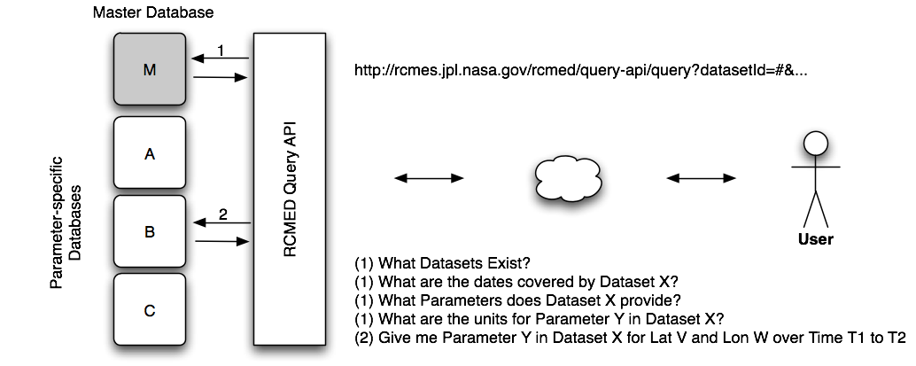
System Architecture...
RCMED Query API
Users interact with RCMED via a powerful Query API which hides the complexity of data access.

Slide 21
System Architecture...
RCMET:
Python-based client toolkit for interacting with RCMED
Browser-based wizard interface for performing configurable processing tasks
Common algorithms for model-to-observational data comparisons

Slide 22
System Architecture...
RCMET aims to:
Facilitate streamlined access and use of the RCMED
Reduce the time required to conduct a model evaluation exercise
Standardize computational tasks

Slide 23
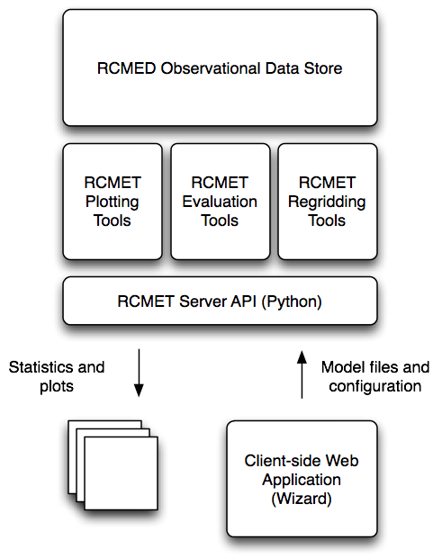
System Architecture...
RCMET Toolkit Stack:
Web-based evaluation configuration interface
Python API for task orchestration
Libraries for common processing tasks
Transparent interaction with RCMED

Slide 24

Supporting Reuse
How does the Regional Climate Model Evaluation System provide a path to greater software reuse?

Slide 25
Supporting Reuse...
Reuse is a key motivation for the development of the RCMES
“Reduce the time required to conduct a model evaluation exercise”
Tools and services to standardize data access and computational tasks
Minimize need for ad-hoc solutions that don’t scale.

Slide 26



Supporting Reuse...
RCMES is built on open source software:
Apache OODT
Metadata extraction and manipulation
MySQL
Data and metadata registration & cataloging
Apache Hadoop + HDFS
Elastic scalability and processing horsepower

Slide 27
Supporting Reuse...
RCME is open source software
RCMET is a freely-available software toolkit that anyone can modify and improve
RCMED is a public data resource for obs. data optimized for the needs of the regional climate modeling community

Slide 28

RCMES Applications
How is the Regional Climate Model Evaluation System being used in the real world?

Slide 29
Applications...
RCMES is a research effort that is still in its early stages
Much of the RCMES software is just becoming publicly available

Slide 30
Applications...
CORDEX:
Chris Mattmann presented RCMES and held a hands-on demonstration in Trieste, Italy in Mar. 2011
Cameron Goodale presented RCMES at CORDEX East Asia in Busan, South Korea in Oct. 2011
JPL and the University of Cape Town, South Africa are exploring the use of RCMES to support CORDEX Africa

Slide 31

Applications...
JPL/UCLA JIFRESSE:
RCMES is currently used to support research at the UCLA Joint Institute for Regional Earth System Science and Engineering.

Slide 32

Applications...
JPL/Howard University:
RCMES is being used to support doctoral research by Kim Whitehall at Howard University in Washinton, D.C.

Slide 33
“The first step is to increase the accessibility of observations and high-resolution simulations to a wide range of users…”
“A second step is to develop an international depository site for model diagnostic tools … and evaluation metrics that would help users assess the reliability of specific aspects of model simulations...”
Overpeck et al,
‘Climate Data Challenges in the 21st Century’
Science, Vol. 331 no. 6018 pp. 700-702, Feb. 2011.

Slide 34
More Information:
http://rcmes.jpl.nasa.gov
{ahart,cgoodale,crichton,mattmann}@jpl.nasa.gov

Slide 35
End.
Thank you very much for your attention!

